Slide 1
What You Need to Know About Financial Aid

Slide 2
Todd Williams Stark State College twilliams@starkstate.edu

Slide 3
Topics We Will Discuss
What is financial aid?
Student aid index (SAI)
Financial need
Categories, types, and sources of financial aid
Free Application for Federal Student Aid (FAFSA®)
Special and unusual circumstances

Slide 4
What Is Financial Aid?
Financial aid consists of funds provided to students and families to help pay for postsecondary educational expenses

Slide 5
Types of Financial Aid
Scholarships
Grants
Loans
Self-Help Aid
Gift Aid

Slide 6
Employers
May have scholarships available to the children of employees
May have educational benefits for their employees

Slide 7
Free Application for Federal Student Aid (FAFSA)
For the 2025-26 academic year, the FAFSA may be filed starting on or before December 1, 2024 (exact date to be determined)
Colleges may set FAFSA priority dates

Slide 8
Free Application for Federal Student Aid (FAFSA®)
Collects demographic and financial information
Information used to calculate the student aid index (SAI)
Colleges use SAI to offer financial aid
Available in English and Spanish

Slide 9
What Is Student Aid Index (SAI)?
Number resulting from the evaluation of a student’s (and family’s) approximate financial resources for a student’s postsecondary education
Student contribution
Parent contribution
(for dependent students)

Slide 10
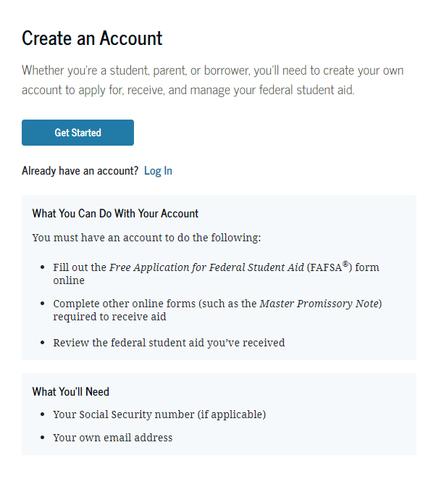
StudentAid.gov Account Username and Password (FSA ID)
Used for FAFSA completion and access to certain U.S. Department of Education websites
Student and parent must create own FSA ID
May be used throughout financial aid process, including subsequent school years
Only the owner should create an FSA ID
Apply at https://studentaid.gov/fsa-id/create-account/launch

Slide 11
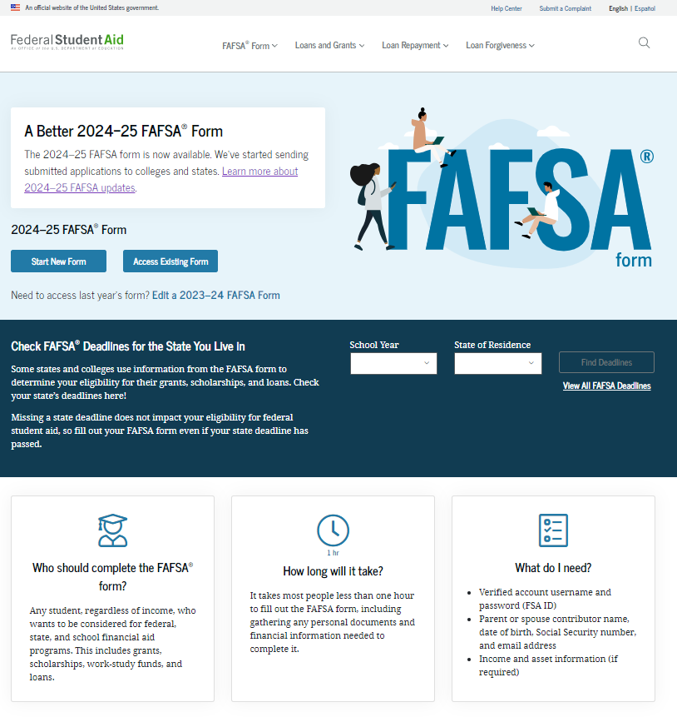
Online FAFSA

Slide 12
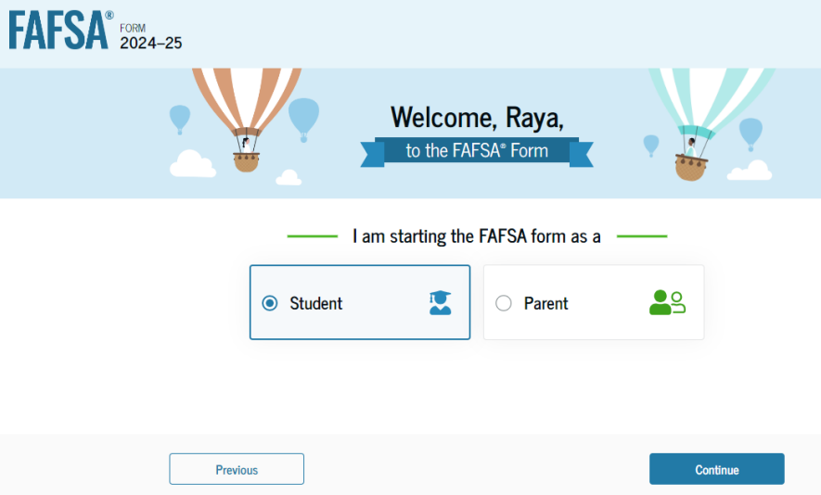
Online FAFSA
Note: Screenshot from U.S. Department of Education’s 2024-25 FAFSA Form Preview Presentation, July 2023

Slide 13
FUTURE Act Direct Data Exchange (FA-DDX)
Allows for an individual’s federal tax information (FTI) to be directly transferred from the IRS to the FAFSA
Consent is required by all contributors on FAFSA
IRS transfers information to populate FAFSA income questions for most tax filers
Eliminates manual entry of tax and income information

Slide 14
Student Information
Identity and contact information
Consent for FTI transfer from IRS
Marital status
College plans
Personal and unusual circumstances

Slide 15
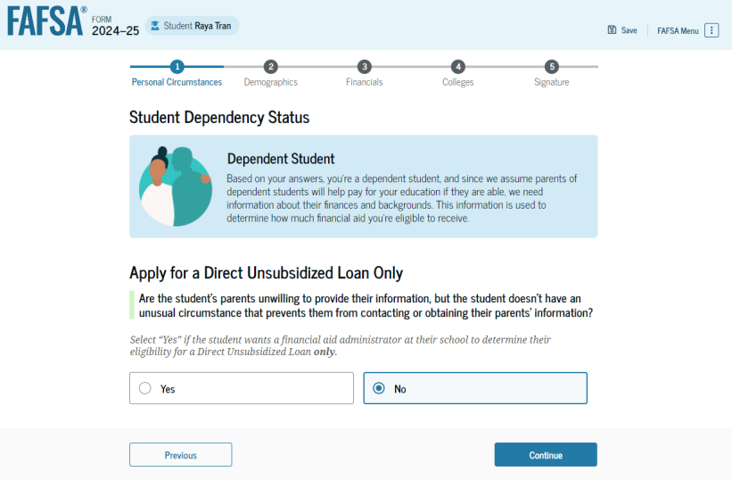
Student Dependency Status
Note: Screenshot from U.S. Department of Education’s 2024-25 FAFSA Form Preview Presentation, July 2023

Slide 16
Student Information
Demographic information
Citizenship status
Parents’ education status
Parent killed in line of duty
High school information

Slide 17
Unusual Circumstances
Conditions that justify an institution making an adjustment to a student’s dependency status
Student does not provide parental data on FAFSA
Considered provisionally independent
Student follows institution’s process for dependency override determination

Slide 18
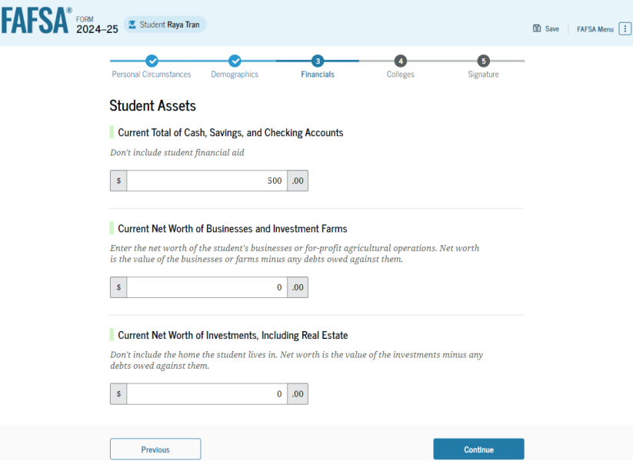
Student Financial Information
Tax return information
Minimal questions if FTI transferred from IRS
Asset information
Note: Screenshot from U.S. Department of Education’s 2024-25 FAFSA Form Preview Presentation, July 2023

Slide 19
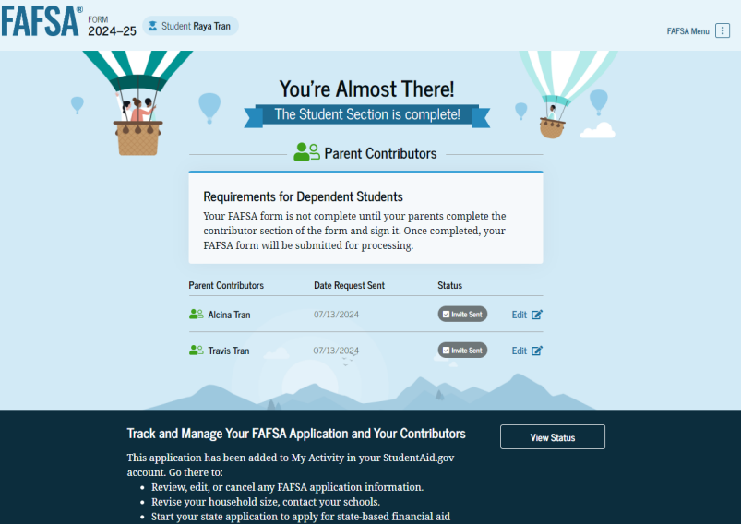
Student Section Completion
College selection
Review of information
Signature

Slide 20
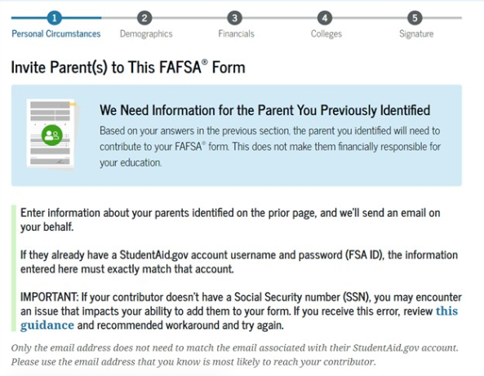
Student Invites Parents to FAFSA
Student provides personal information about parents to invite them to complete parent portion of the FAFSA
Note: Screenshot from StudentAid.gov

Slide 21
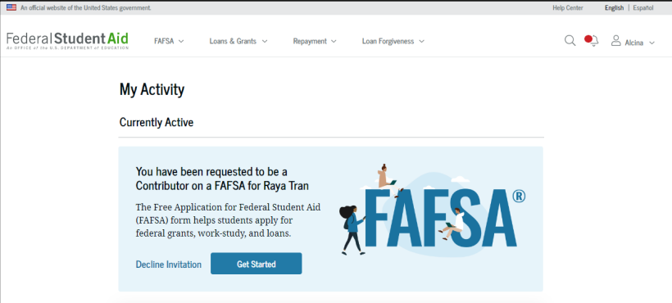
Parent Invitation
Email invitation to complete parent portion of student’s FAFSA
Parents must use FSA ID to access FAFSA
Note: Screenshot from U.S. Department of Education’s 2024-25 FAFSA Form Preview Presentation, July 2023

Slide 22
Parent Information
Identity and contact information
Consent for FTI transfer from IRS
Marital status
State of legal residence

Slide 23
Parent Financial Information
Receipt of means-tested federal benefits in the previous two years
Tax filing status
Family size and number in college
Tax return information
Minimal questions if FTI transferred from IRS
Assets
Other parent information

Slide 24
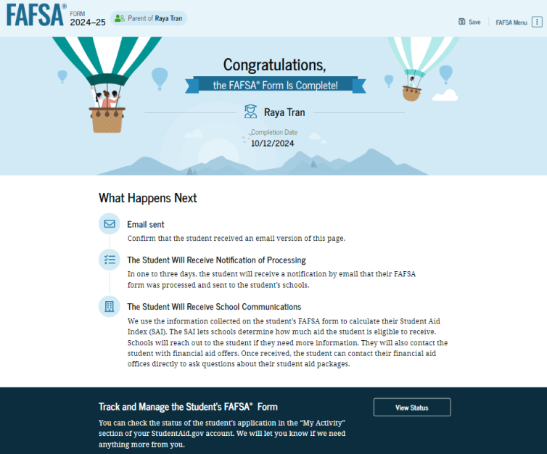
Parent Section Completion
Review of information
Signature and submission of FAFSA
Note: Screenshot from U.S. Department of Education’s 2024-25 FAFSA Form Preview Presentation, July 2023

Slide 25
Other Considerations
If independent student is married, spouse information is required as well
Consent to transfer FTI from the IRS is required for ALL contributors
Including student, student’s spouse (if applicable), parent, and other parent (if applicable)
Students, parents, and preparers may start, complete, and submit a FAFSA

Slide 26
FAFSA Submission Summary
Four sections:
Eligibility Overview
FAFSA Form Answers
School Information
Next Steps
Ability to print summary
Note: Screenshot from U.S. Department of Education’s 2024-25 FAFSA Form Preview Presentation, July 2023

Slide 27
Making Corrections
If necessary, corrections to FAFSA data may be made by:
Using online FAFSA;
Updating paper FAFSA Submission Summary; or
Submitting documentation to college’s financial aid office

Slide 28
Special Circumstances
Different than unusual circumstances (dependency overrides)
Unique conditions exist that cannot be documented with the FAFSA, or circumstances have changed since filing
Student should contact institution’s financial aid office for more information
Decisions are final and cannot be appealed to U.S. Department of Education

Slide 29
Special Circumstances
Unusual uncovered medical/dental expenses
Secondary school tuition
Extraordinary dependent care
Parent or spouse death
Additional family members in college
Loss of employment or income
Divorce

Slide 30
Questions?

